Slide 1
Project on Event management system
By
Anshuman Kesari (12100309)
Sharad Yadav (12104408)
Piyush Bhatia (12104522)
K21WB

Slide 2
Abstract
The Event Management System is a Java-based desktop application designed to help users manage their events.
It allows users to add new events, view existing events, and clear fields as needed.
The system features a graphical user interface with intuitive controls, including text fields, buttons, and a table for displaying event data.
Users can also register for an account, which requires entering basic personal information.
The application includes a login page, which validates user credentials before granting access to the system.
The Event Management System demonstrates the use of Java programming language and GUI components to build a practical, user-friendly application for managing events.

Slide 3
Introduction
This program is an implementation of an Event Management System that allows users to add events, view events, and log in. It has a graphical user interface created using the Swing library in Java.
The program consists of two JFrames - the main JFrame for the Event Management System and a secondary JFrame for the login page. The main JFrame contains a form with input fields for the event name, date, and time, as well as buttons to add an event, view events, and clear the input fields. It also contains a JTable to display the events that have been added. The secondary JFrame contains input fields for the username and password, as well as buttons to log in and clear the input fields. There is also a Register button that opens a new JFrame to allow users to register.
The program uses a DefaultTableModel to store the events that have been added, and the addBtn ActionListener adds the input data to the table using the addRow() method. The viewBtn ActionListener displays the events that have been added by iterating through the rows of the tableModel and displaying the data in a JOptionPane. The loginBtn ActionListener checks the username and password input fields and displays an error message if they are incorrect. If the credentials are correct, the main JFrame is displayed, and the login JFrame is hidden.
Overall, this program provides a basic implementation of an Event Management System with a graphical user interface. However, there is no implementation for storing data in a database or file, and there is no validation for the input fields or user registration. These functionalities could be added to make the program more robust.

Slide 4
Flow Chart
Start
Input given is username and password
Click on Login
Correct Values
Incorrect Values
Login Successful
Stop

Slide 5
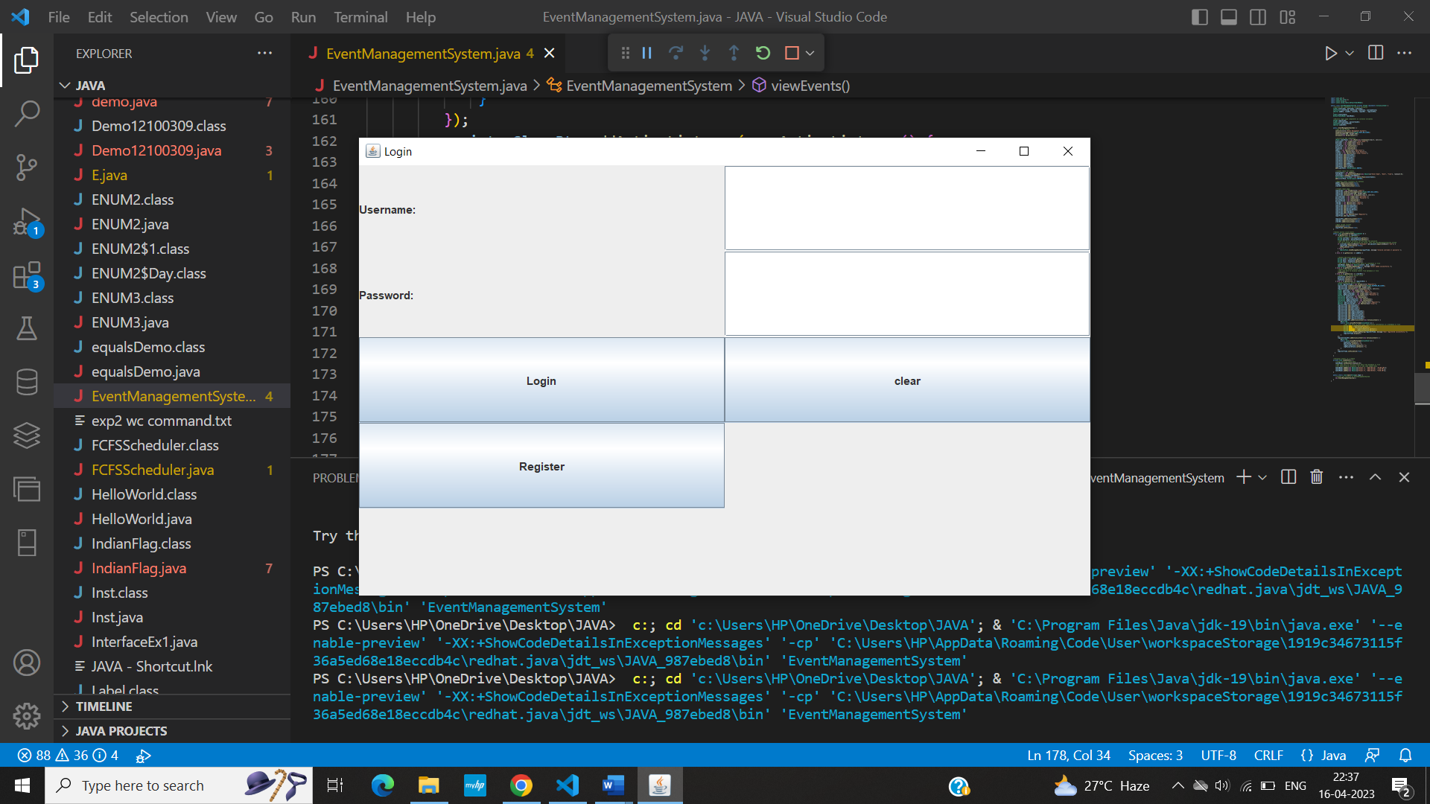
ScreenShots

Slide 6
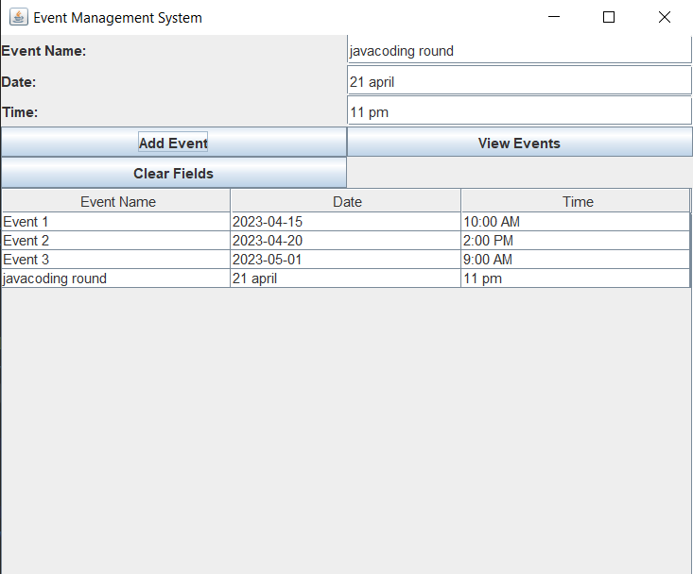
View event page

Slide 7

Add Event Page

Slide 8
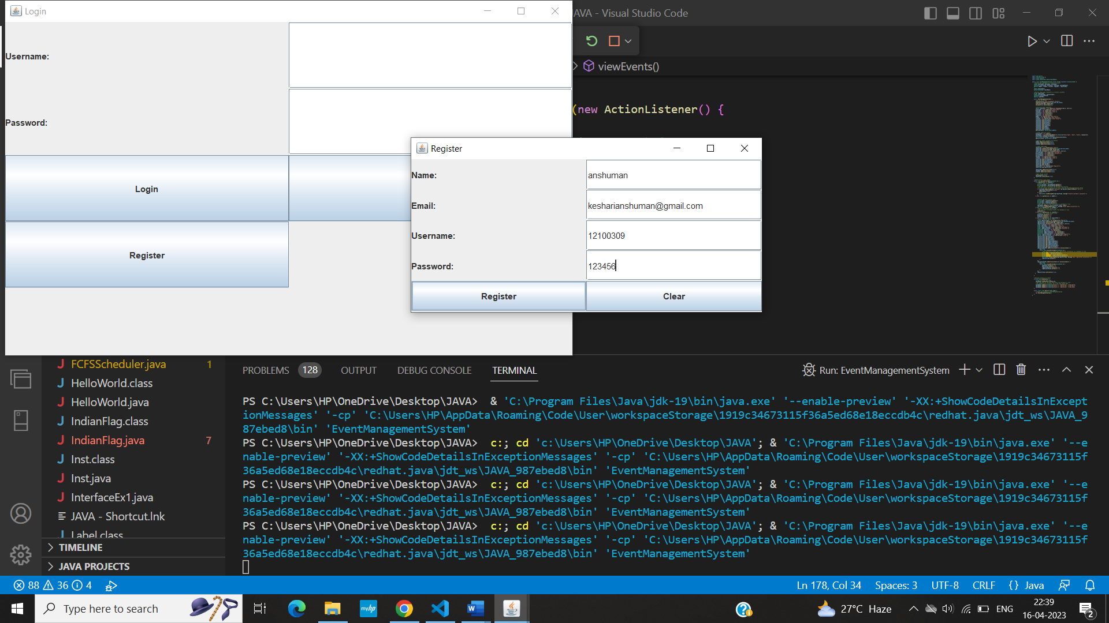
Register Page

Slide 9
Real Time Applications
Automate certain tasks and processes, saving time and reducing errors
Provide data analysis and insights, enabling informed decision-making
Improve communication and collaboration within a team or organization
Increase efficiency and productivity by streamlining workflows
Enhance customer experience by providing better service and support
Enable remote work and collaboration, increasing flexibility and accessibility
Support innovation and experimentation by providing a platform for testing new ideas
Enhance security and compliance by enforcing policies and controls
Increase scalability and adaptability, enabling the project to grow and evolve over time.

